Slide 1
Bridal, Beauty Salon & Academy Management System
Batch 02 Group 05

Slide 2
Group Members
1. De Silva S.S.R.D.M. IT15102560
2. Ranasinghe R.A.N.I. IT15127174
3. Athipola R.W.S.K. IT13045722
4. Kumarasiri S.D.D.C. IT15134936
5. Ratnayake R.M.T.U. IT15127938
6. Chathubhashini N.D.J. IT15134554
7. Kahaduwa K.K.U.S. IT15134240
8. Dolawatta I.H. IT15140562

Slide 3
Content
1. Introduction
1.1 Client Introduction
1.2 Problem Specification
1.3 Solution Outline
1.4 Key Benefits
2. Objectives
3.Project plan
4. Procedure
5.Personnel and Facilities
6.Software and Hardware Requirements

Slide 4
1.Introduction 1.1Client introduction
Client - Hasini Gunasekera Salon's (Pvt.) Limited is Sri-Lanka's pioneering Bridal, Beauty salon & Academy located in Nugegoda.
Current situation -They have a manual system for all the processes in the salon.
Business - Manage academy, Treatments handling, Wedding packages
Requirements - Automate the system such as : Handle employees & appointments, Manage academic affairs, Inventory control

Slide 5
1.2 Problem Specification
Less Accuracy in calculations
Complexity in updating details
Time consuming
Inaccurate searching results
Problems with keeping reminders manually
Slow communication methods among employees
Problems with keeping track of the inventory

Slide 6
1.3 Solution outline
Automated and accurate calculation
Fast and Easy to update details
Accurate search results
Automated notifications and reminders
Easy communication among employees within the system

Slide 7
1.4 Key Benefits
1.Storing data in better organizing manner.
2.Can compare the income and expenses with other months and years.
3.Have facility to search and update records easily and secure information for the access.
4. Improve the efficiency

Slide 8
2. Objectives
Eliminate unnecessary paper work and time taken for data processing
Improve efficiency and accuracy in transaction processing.
Save customers and employees time by scheduling work.
Manage customer and student details efficiently.
To produce required reports to ease the decision making process

Slide 9
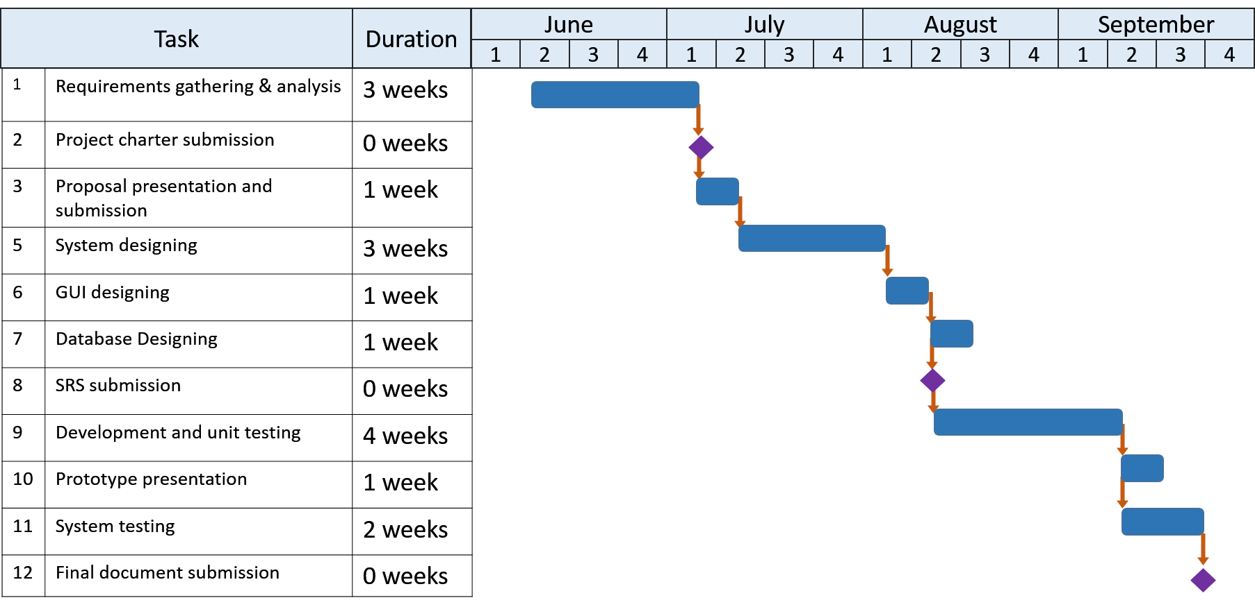
3. Project Plan

Slide 10




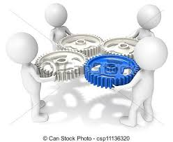



4.Procedure
HH
Handle Appointments
Salon services
Student Management
Salon
Course Management
Bridal services
Academy
Inventory
Finance
Manage employees

Slide 11
5.Personnel & Facilities
Personnel | Module | Facilities
De Silva S.S.R.D.M | Handle appointments | Check availability from nearest branch on specific beautician for on call customers Customer registration Payment calculation and handle discounts special offers(for customer’s anniversaries, birthdays and special occasions)
Ranasinghe R.A.N.I | Manage employee details | Manage attendance Handle employee details Special offers for employees Shift appointments Generate reports about most selected treatments and target.

Slide 12
Athipola R.W.S.K | Manage salon services | Manage salon packages Handle treatments Manage patch test issues Get customer feedbacks
Kumarasiri S.D.D.C | Manage student details | Student registration management Student attendance handling Handle course payments Student grading
Ratnayake R.M.T.U | Manage inventory control | Manage stocks Register and maintain suppliers Make notification about stock shortage Generate reports about product movement

Slide 13
Chathubhashini N.D.J | Manage courses | Arrange halls Handle course details Give notification message when student limitation exceeds
Kahaduwa K.K.U.S | Handle finance and issue receipts | Manage expenses Profit calculations Generate financial reports Mange salary and allowances
Dolawatta I.H | Manage bridal services | Manage wedding packages Customize wedding packages Costume renting Calculate extra charges Check costume availability

Slide 14
6.Hardware and Software Requirements
Hardware Requirements
Hard Drive Space :- At least 2.0 GB free space
Screen Resolution :- 1024 x 768 pixel minimum resolution required
Software Requirements
Java runtime environment 8
Operating System : Any Windows Linux or Mac platform
Processor :- 1.5 Ghz Intel Pentium or Better
My SQL community server 5.5 or higher.

Slide 15
Thank You..

